Slide 1
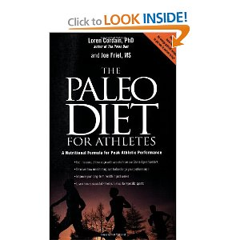
Evaluating nutritional claims
Metabolic Diseases Lesson 5.1

Slide 2
Do Now
How can you apply what you have learned in this module to your own life?

Slide 3
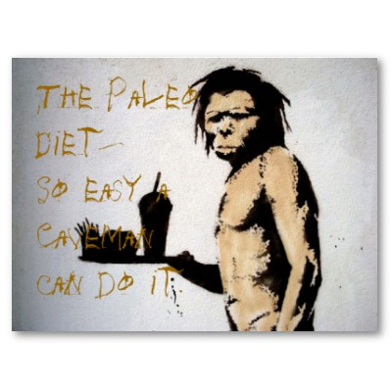
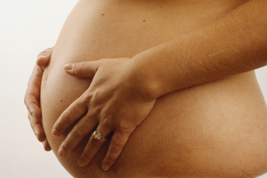
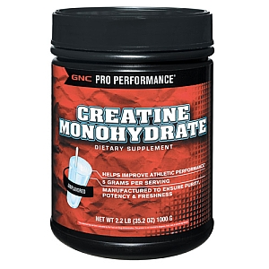
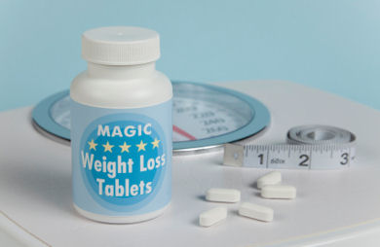
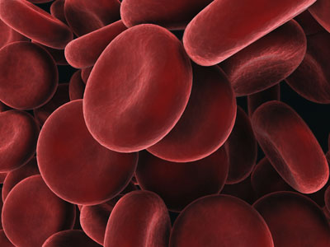
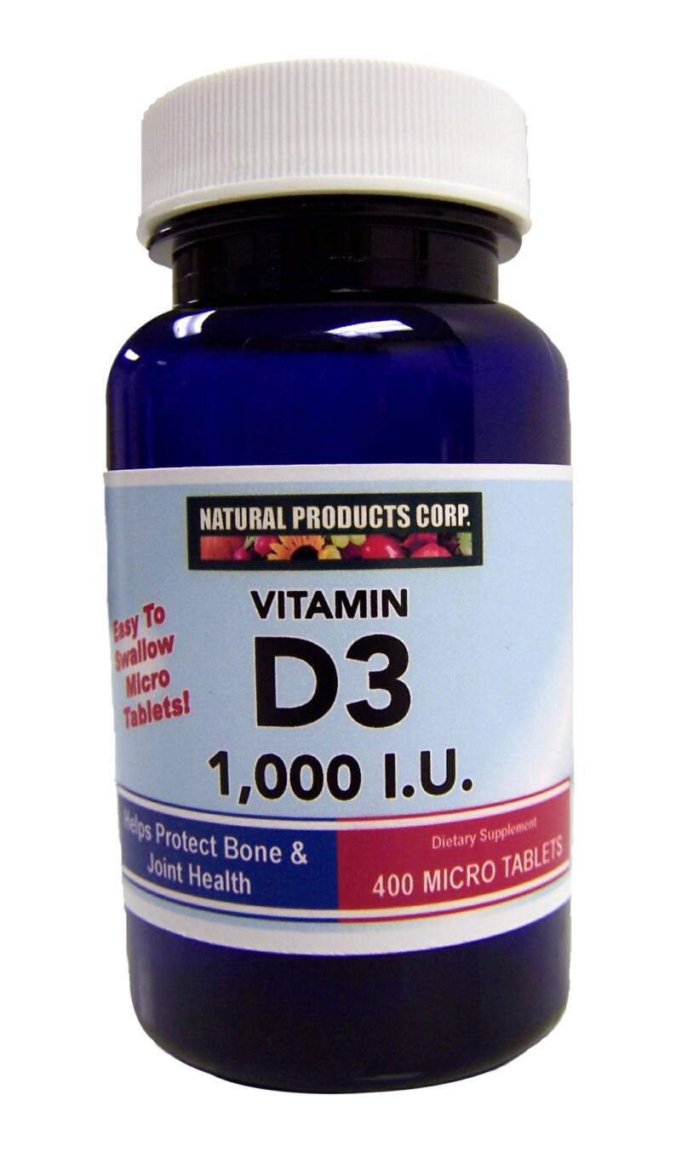
Project Topics: Diets and Supplements
Paleo diet
Pregnancy:
Do and don'ts
Muscle building
supplements
South Beach diet
Adolescents:
Do and don'ts
Weight loss
supplements
Blood type diet
Infants:
Do and don'ts
Other dietary
supplements

Slide 4
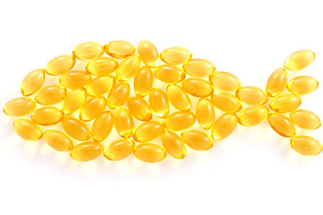
What should you consider when evaluating a claim?
For example –
“Omega 3 fatty acids prevent heart disease!”
Do they?
What information do you
need to make this claim?

Slide 5
Activity:
Design a checklist you can use to evaluate nutritional claims and recommendations
Break into your final project groups
Use your final project topic to form your checklist

Slide 6
Wrap Up
Present your checklist to the class!

Slide 7
Homework
Use the Lesson 5.1 Homework Worksheet to practice searching for content online.

